Slide 1

Bilingual Education In The Netherlands
Why TTO?

Slide 2
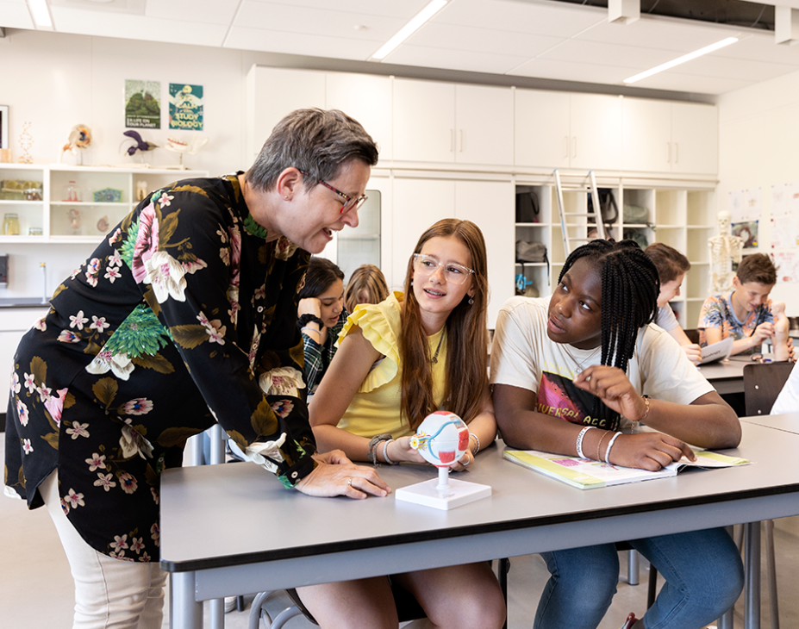
TTO in a nutshell
Junior TTO (1-3): ± 50% of subjects & activities in English
English
Maths
Geography
History
Biology
Physical Education
Senior TTO (years 4-5-6): roughly 25% of subjects and activities are in English

Slide 3

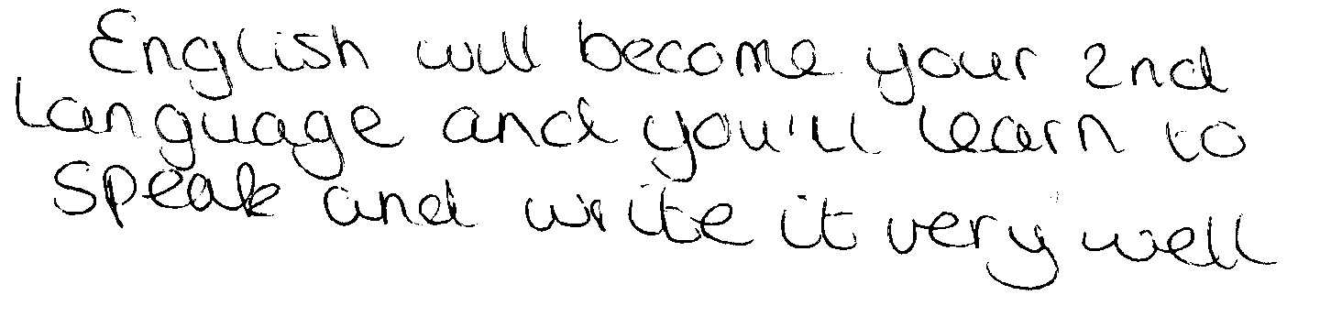
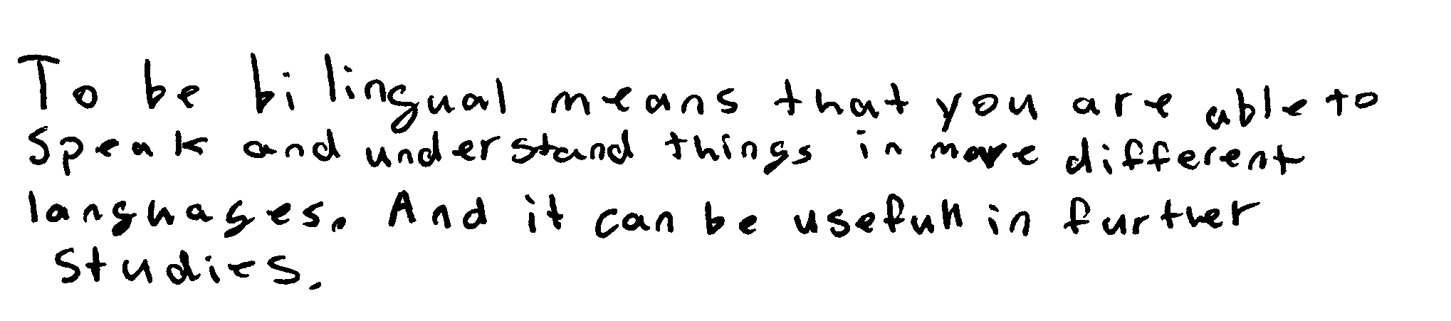
Personal level
TTO for you?

Slide 4

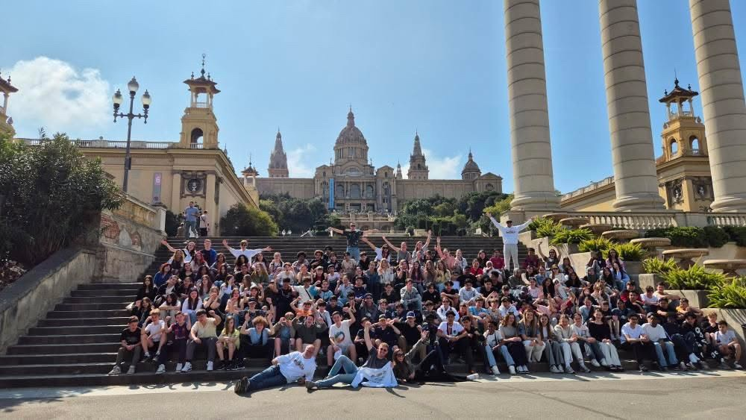
TTO and individual growth
Personal development & world orientation
Additional Exams, Courses and Certificates:
International Baccalaureate: English
Cambridge Checkpoint Certificate
TTO Junior & Senior certificates
Additional School Activities:
MUN (Model United Nations)
English speaking contest / Debate Team
International exchanges, experiences or trips:
UK, Germany, France, India, China, Spain, Italy, Indonesia, Peru (May vary per year and course)
Guest houses, hostels and/or pupil homes

Slide 5


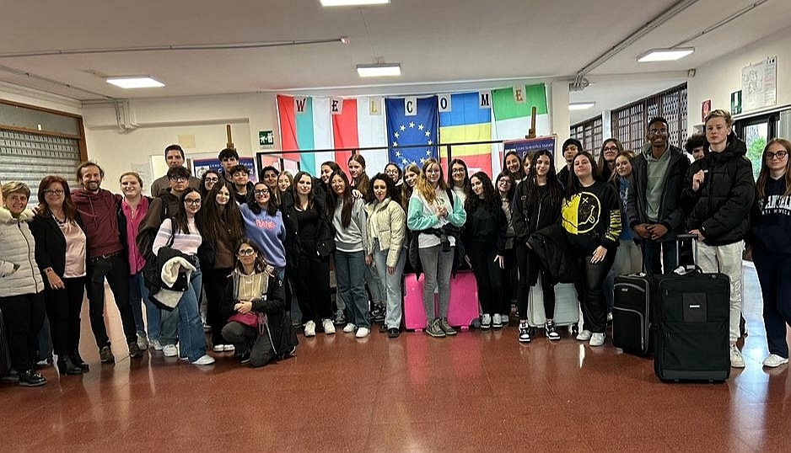

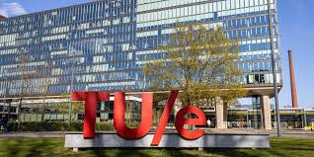
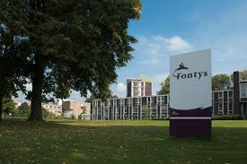
TTO & Educational networks
Brainport Eindhoven,
European Union,
TTO schools' network,
Exchange partners
Nuffic
Cambridge International Exams
Trion
Universities: TU/e, Leiden & Amsterdam
Universities of applied sciences: Fontys

Slide 6
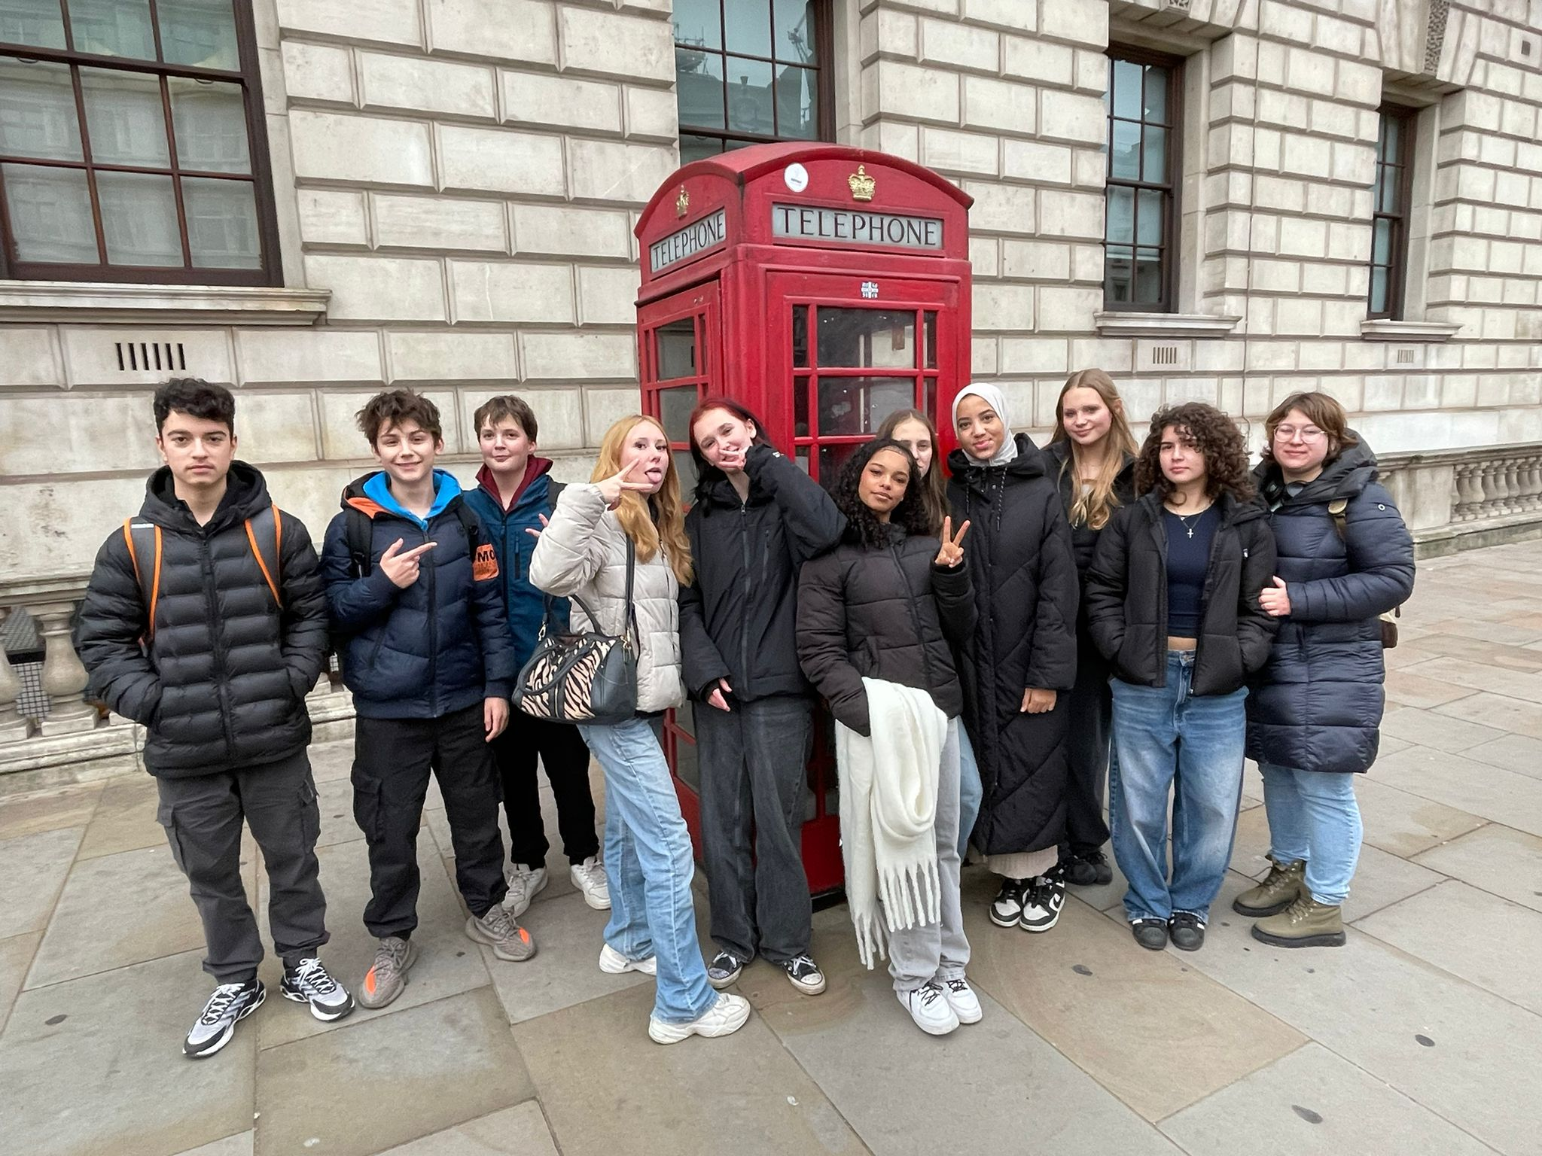
International Level
English is slowly becoming the “unofficial lingua franca in Europe” (Tosi,1991)
English may have economic, cultural and political advantages in a growing global society. (Phillipson, 2003)
“Many university courses are available in English in the NL.
IT- sector
Medicine
Education: Master degrees
Business
Aviation

Slide 7
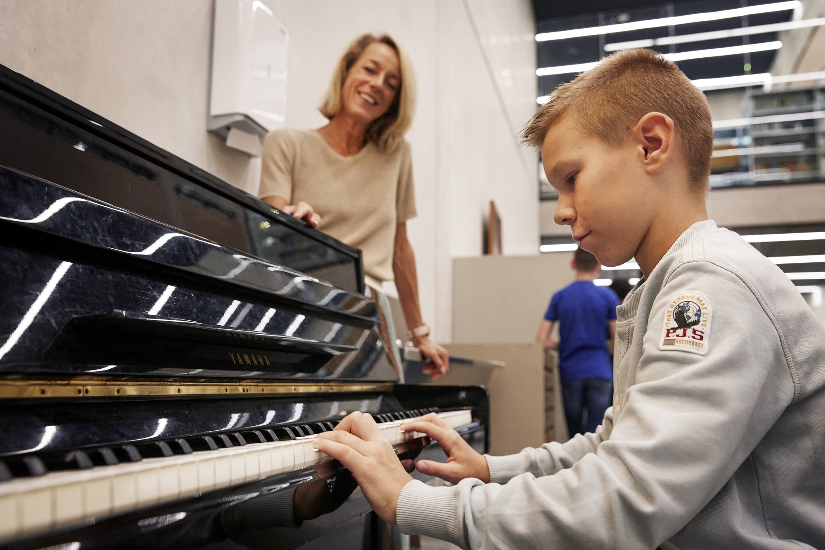
What can you expect?
Honeymoon period
Homework will take longer to complete.
It takes about eight weeks to find the rhythm.
It takes about 16 weeks to adjust to the use of English as a medium of instruction.
There may be periods of frustration

Slide 8
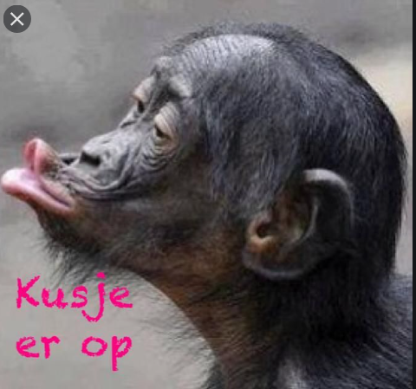
What can you do to support your child?
Moral support
Make sure homework is completed
Keep the school informed
Use of IT resources (Chromebooks)
Spell checker
Dictionaries, thesaurus, pronunciations

Slide 9
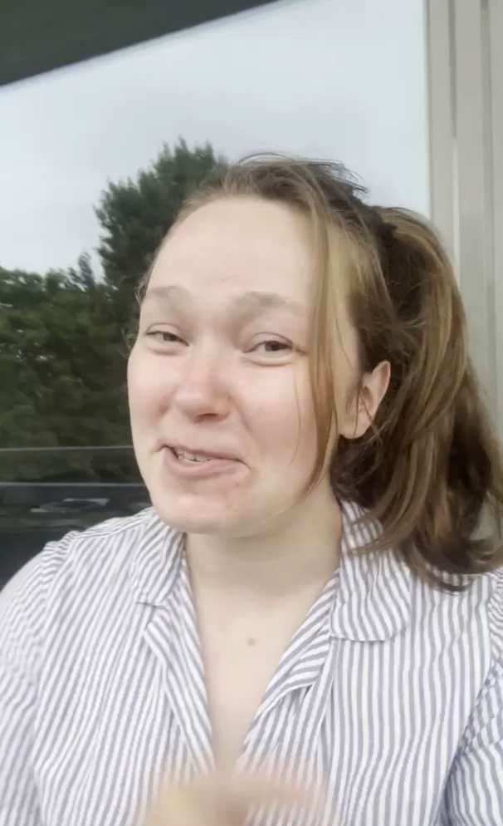

Future perspective

Slide 10
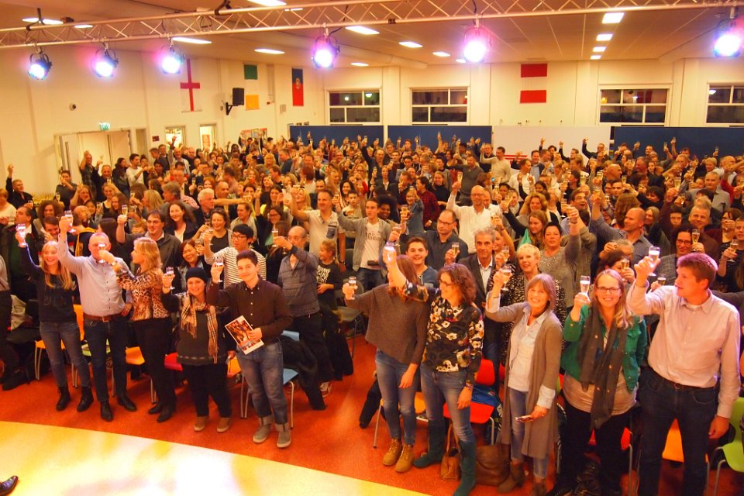
Opendag
OPEN DAG
Zondag 1 februari
10:00 tot 15:00 uur
OPEN DAY
Sunday 1 February
10:00 tot 15:00 uur
Join the Party!

Slide 11
Q & A?
Jouw weg
Jouw toekomst

