Slide 1

Welcome
Parents’ Information Evening 2025
“SCE your ticket to ride!”
Notes:
Bij ons op school leer je nieuwe dingen en vind je een plek waar je je snel thuis voelt. Vanaf begin dit schooljaar zitten we in een spiksplinternieuw schoolgebouw. Een gebouw waar we trots op zijn. We waren er klaar voor. Ons oude gebouw paste niet meer bij onze nieuwe manier van lesgeven.
In dit gebouw kunnen we jou helemaal zien, kun jij worden wie je bent en je talenten ontdekken in ons eigentijds onderwijs. Leuk dat je er bent! Welkom.

Slide 2
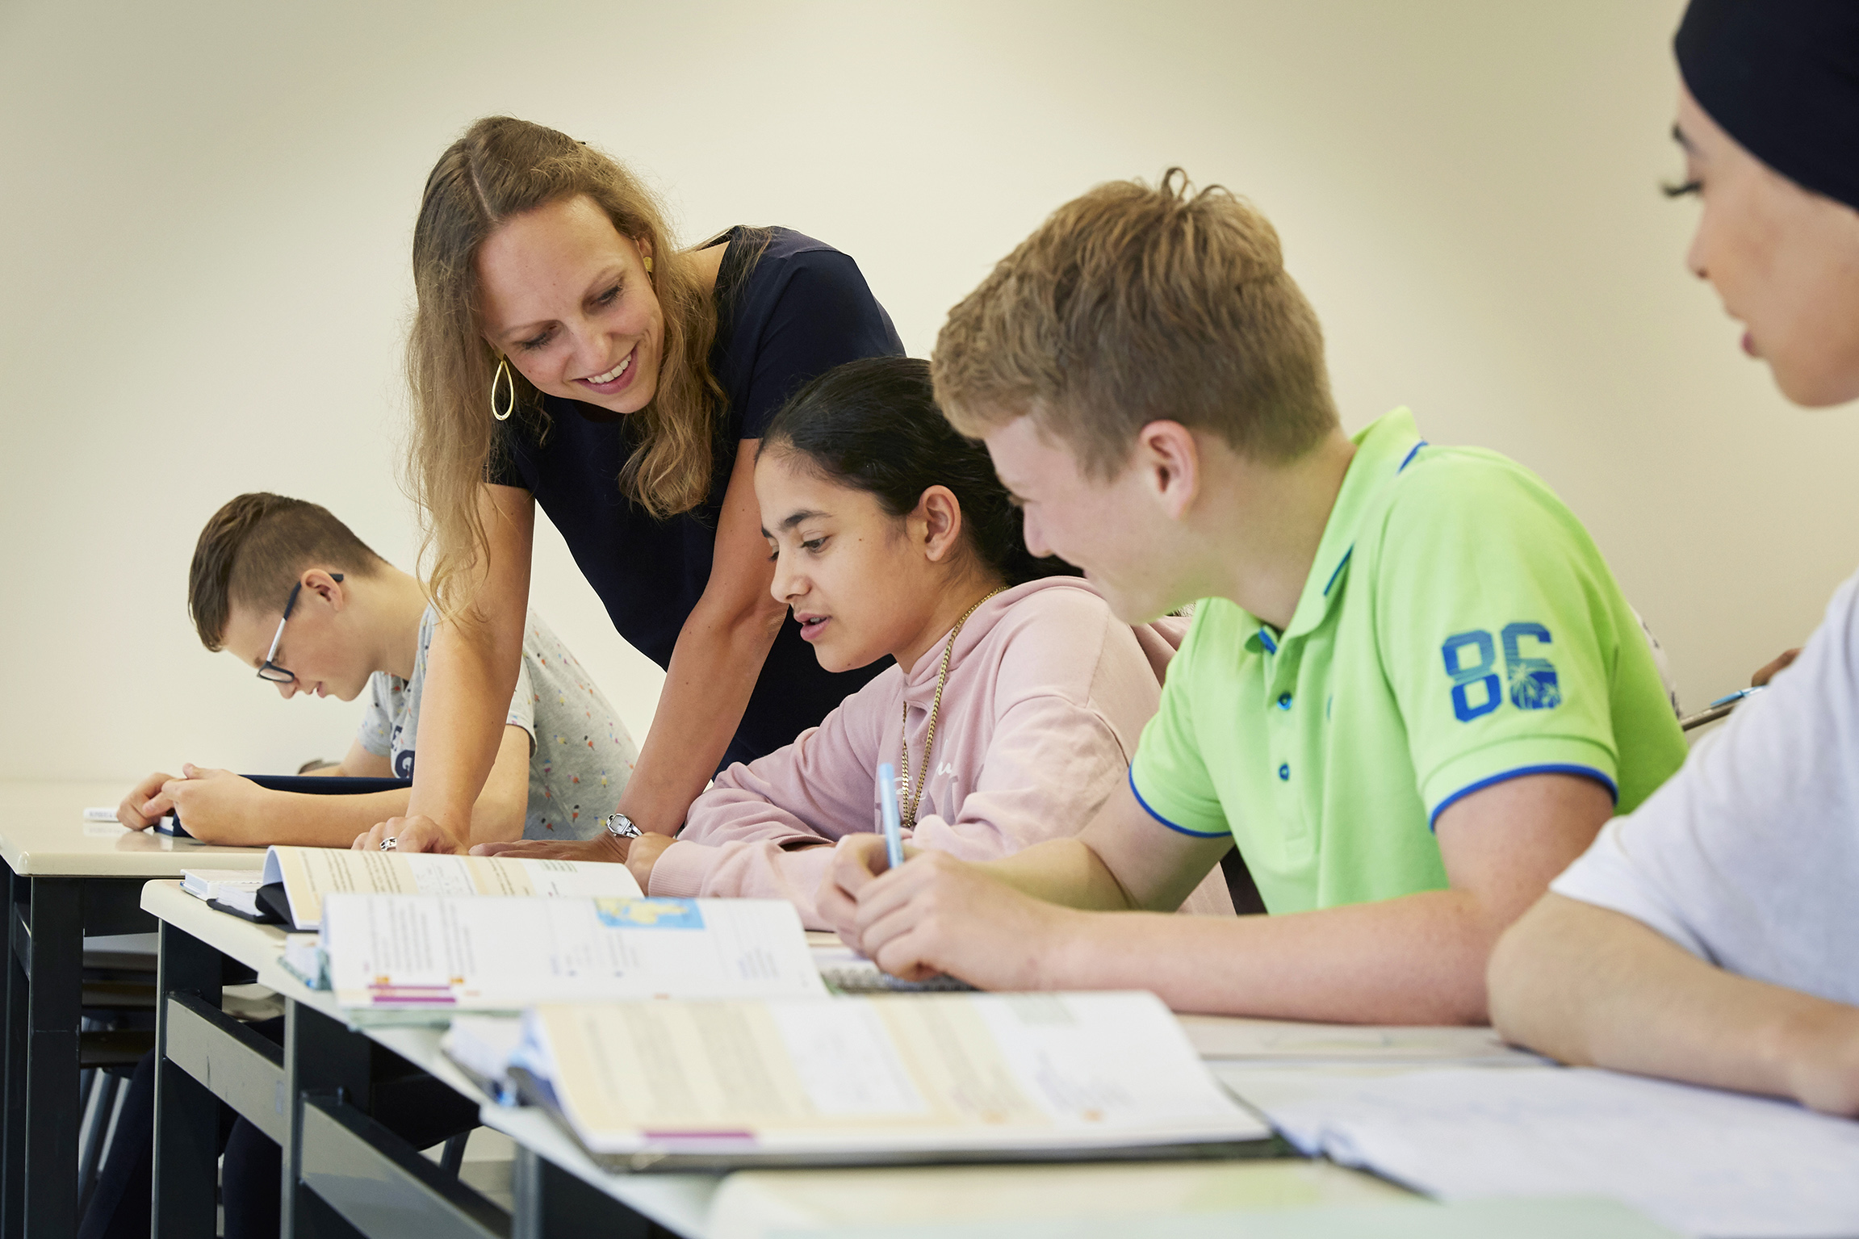
Programme
Part 1: Introduction: SCE in a Nutshell
Looking at the different educational routes available and what we have on offer in terms of additional cultural and educational programmes, enrichment and personal development.
Part 2: Focus points:
Choose one of the following topics and discover more about our schools’ unique educational opportunities.
TTO: Bilingual education: You may stay here!
NT2 :Dutch as a second language : Room 9.35
Leerlingcoaching: Student guidance: Room 9.36
De Campus: Thematic education: Student lounge 10.01
VWO Plus: Pre-University enrichment programme: Room 9.38

Slide 3
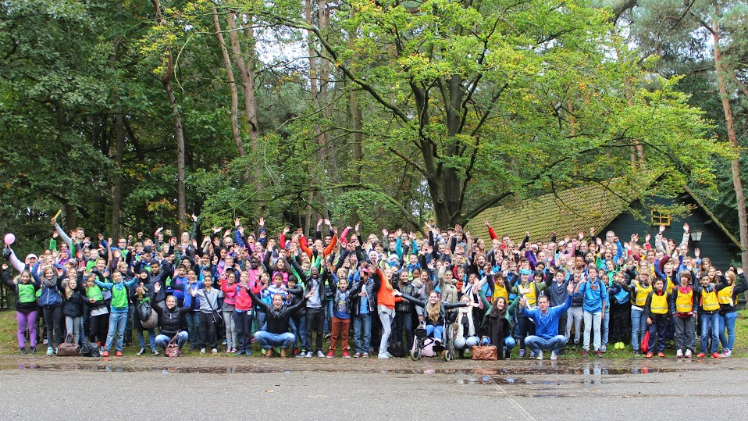
Open day
1 February 2026
SCE in a nutshell!
A public school with ± 1500 pupils and more than 30 nationalities!

Slide 4
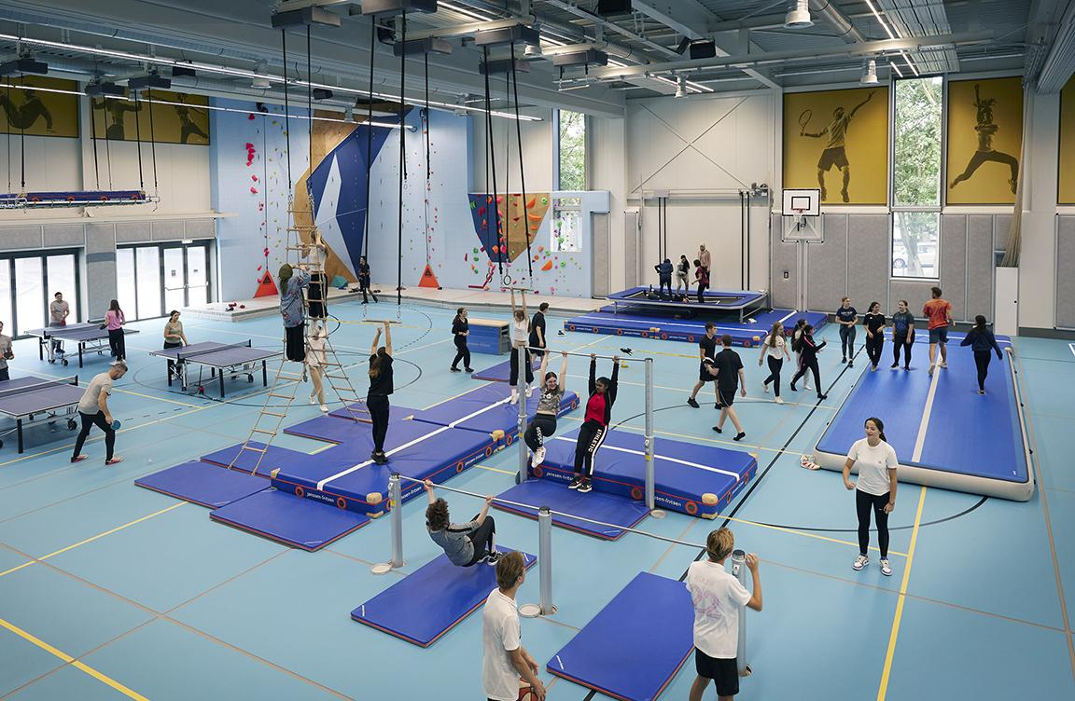
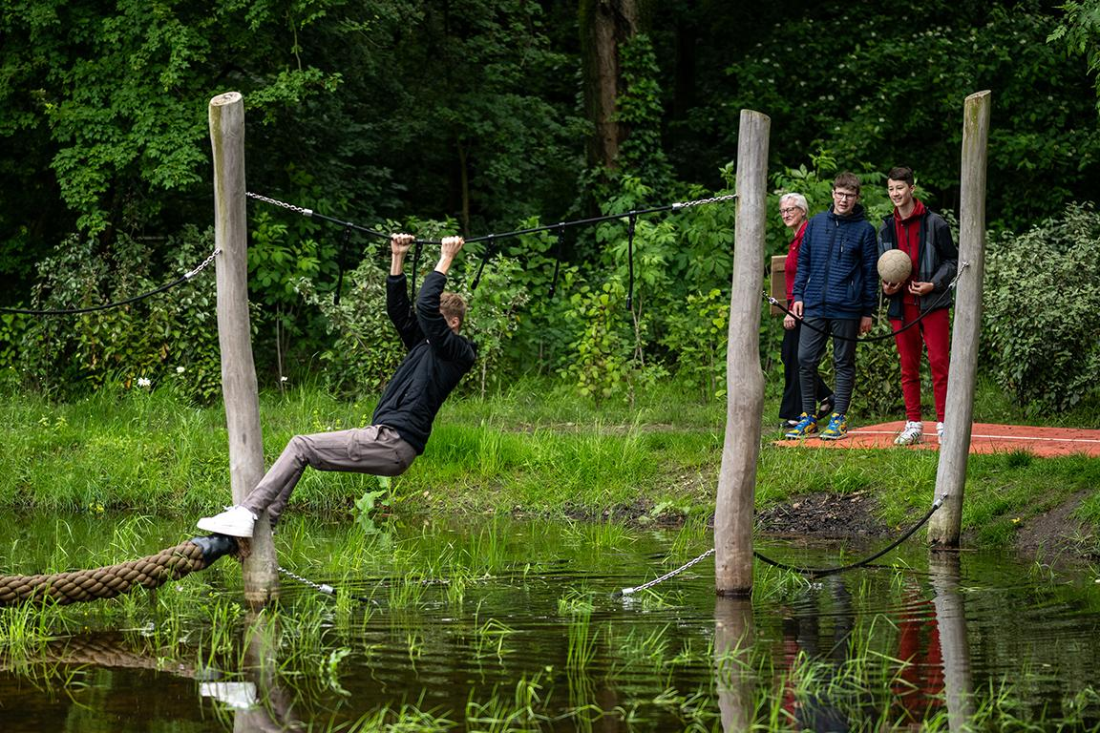
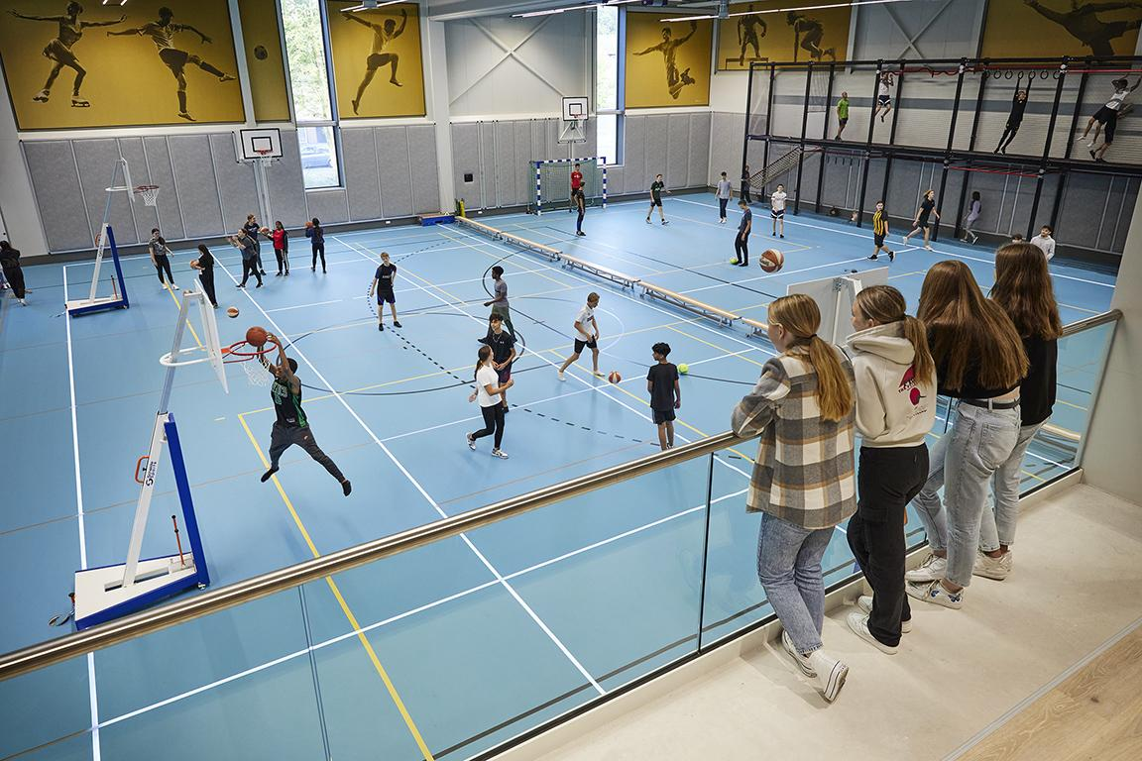
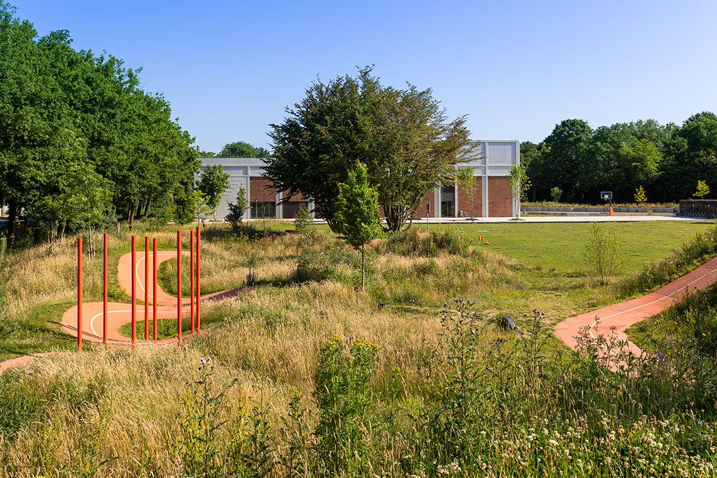
SCE in a nutshell!
An Inspiring Learning environment
Multi-Functional
Sports hall
Outdoor Fitness
&
Cross country Course

Slide 5
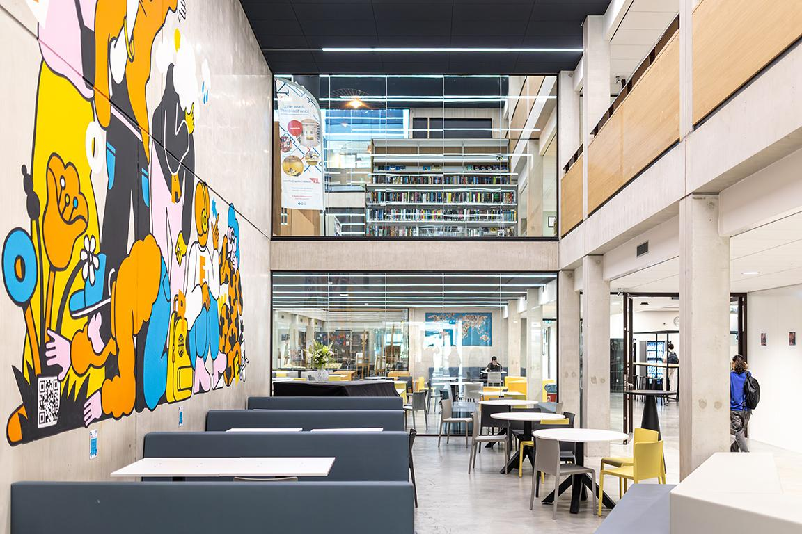
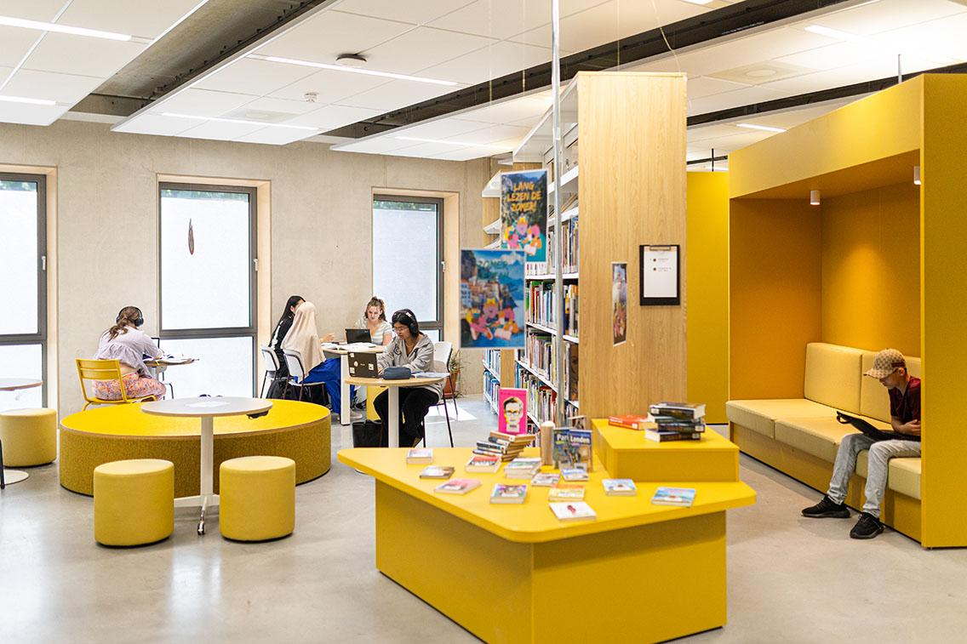
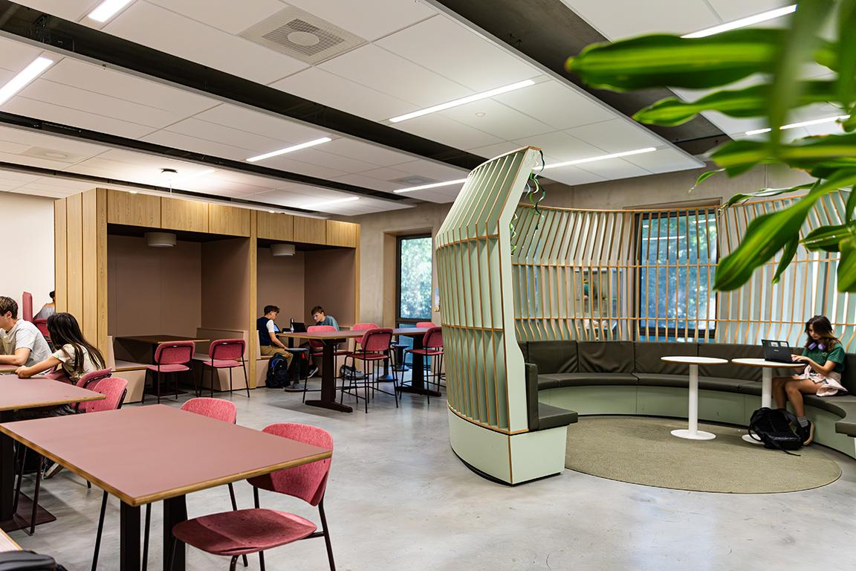
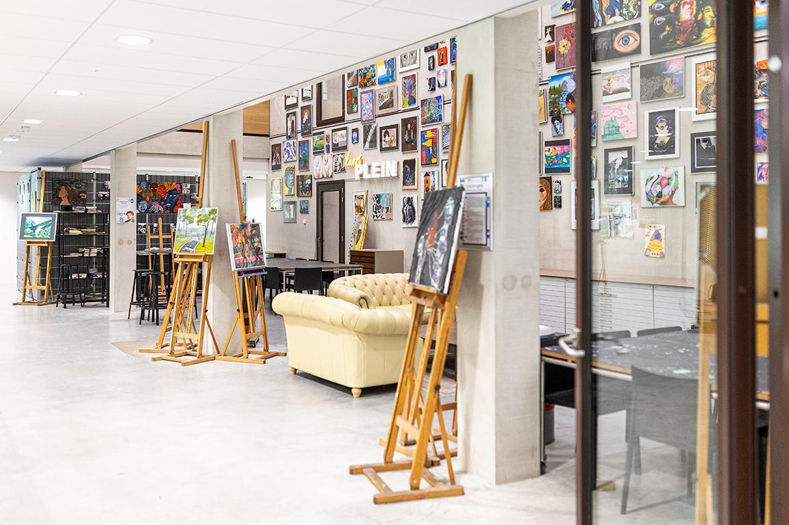

SCE in a nutshell!
An Inspiring Learning environment
A beautiful building with a library, cafeteria, student lounges and workspaces

Slide 6
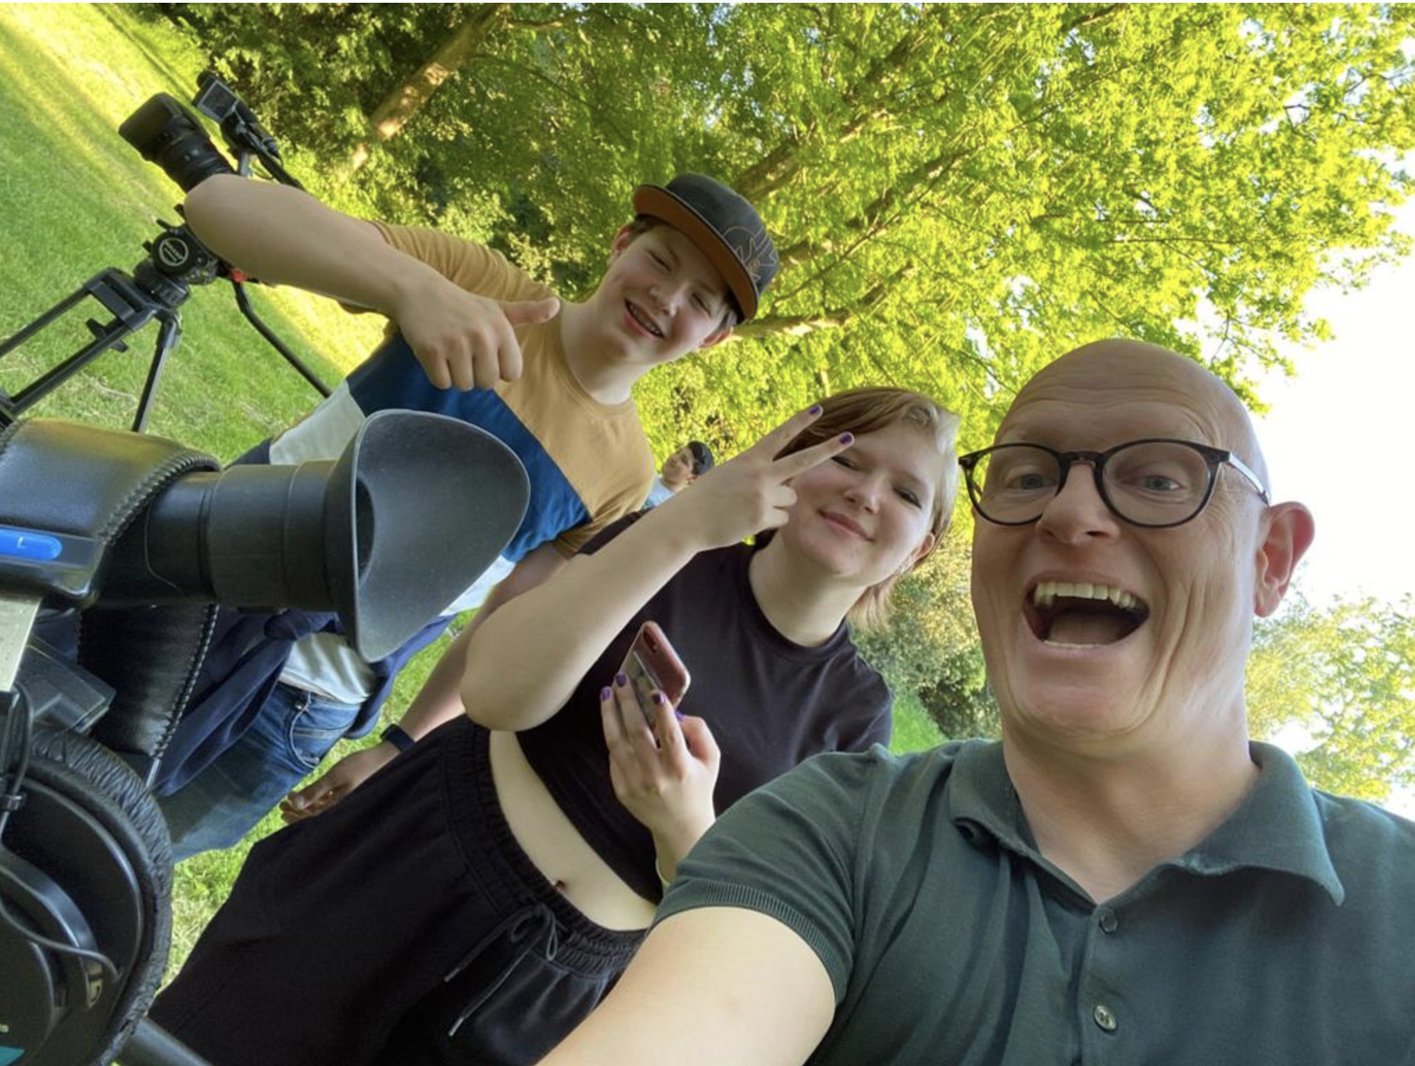
Personal development & world orientation
SCE and individual growth
Additional Exams, Courses and Certificates:
International Baccalaureate: English
Cambridge Checkpoint Certificate
Anglia, French, German, Chinese certificates
TTO Junior & Senior certificates
Additional School Activities:
MUN (Model United Nations)
English speaking contest / Debate Team
School band, Afterschool Sports
International exchanges, experiences or trips:
UK, Germany, France, India, China, Spain, Italy, Indonesia, Peru (May vary per year and course)
Guest houses, hostels and/or pupil homes

Slide 7
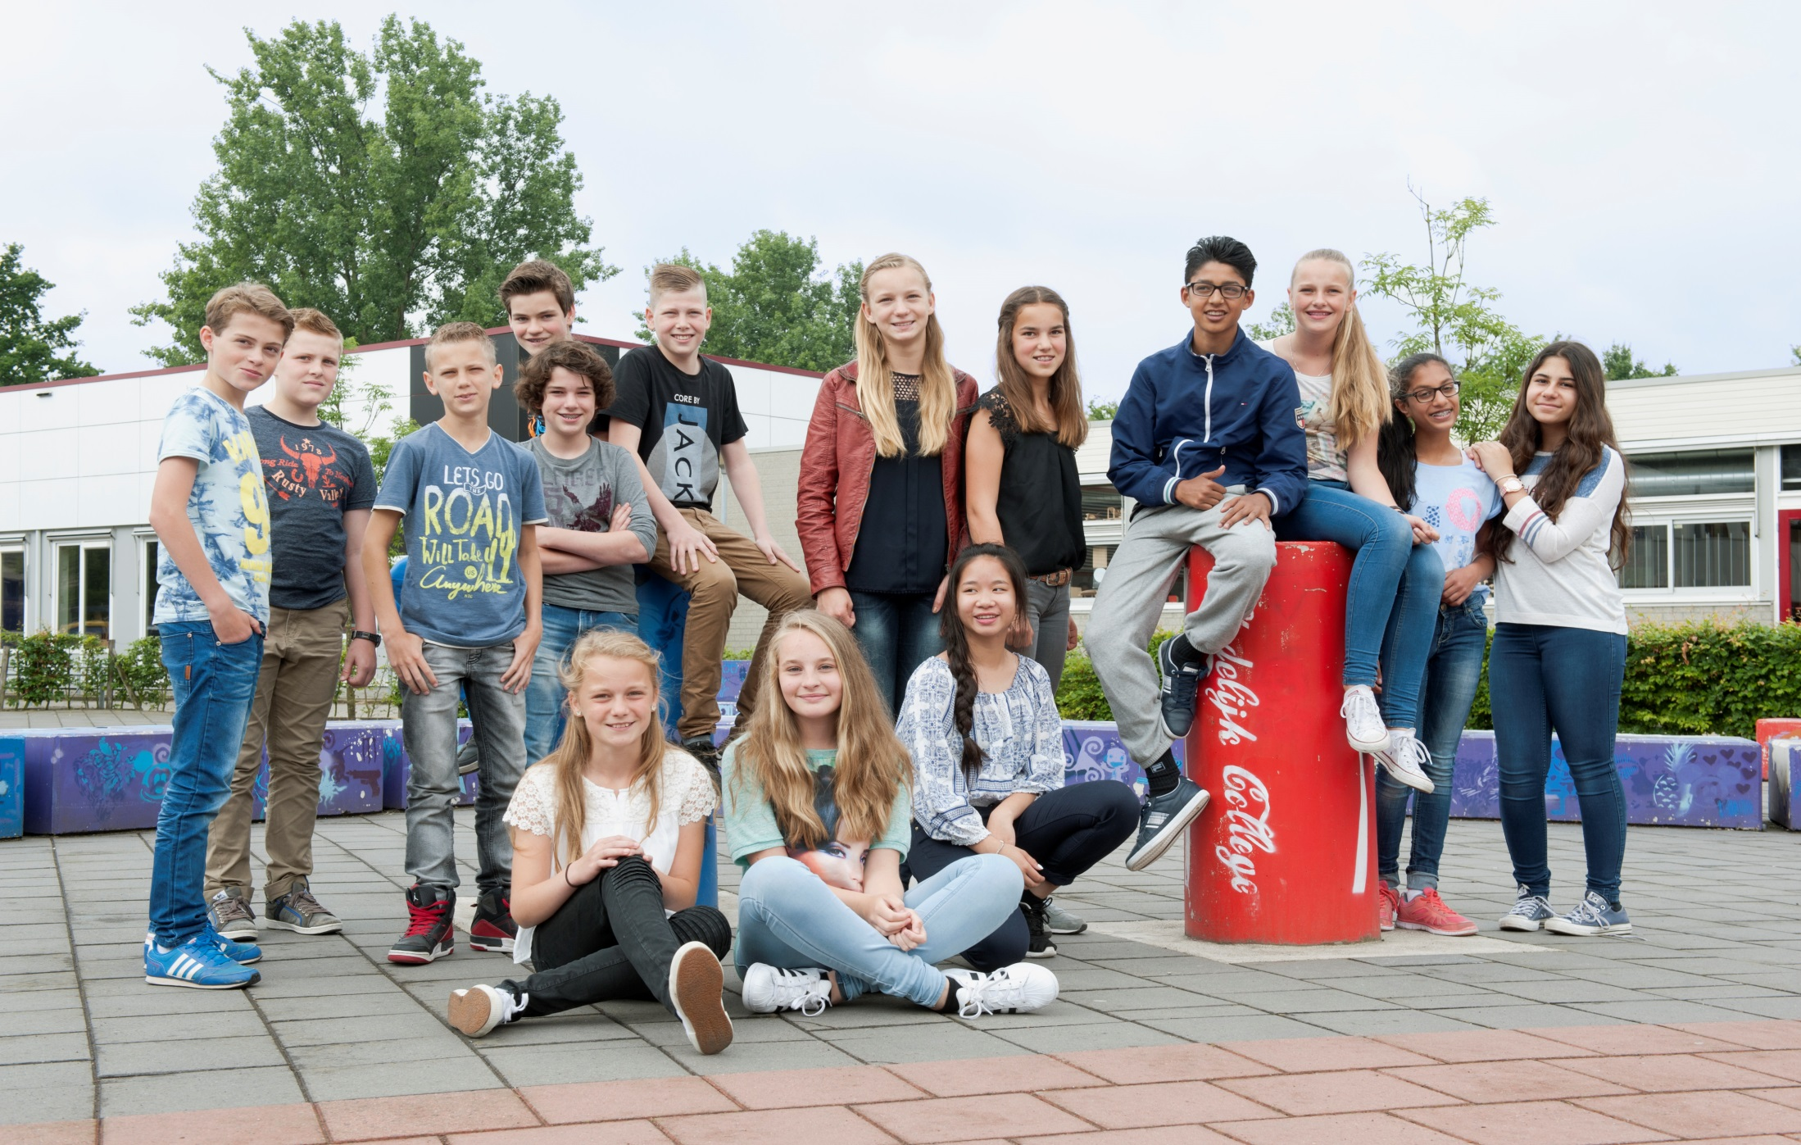
A home away from home!
Wellness
&
Wellbeing
Individual personal wellbeing
Coach and mini-coach.
Academically enrichment programme. “VWO Plus”
Extra guidance and support activities:
“Plusuren” (Addition lesson in a specific subject)
Social skills training.
Exam skills training (Fear of failure)
Quiet room “Intermezzolokaal”
Study coaching and/or homework guidance
Support and partnership with the local health and studende guidance counsellor (GGD)

Slide 8
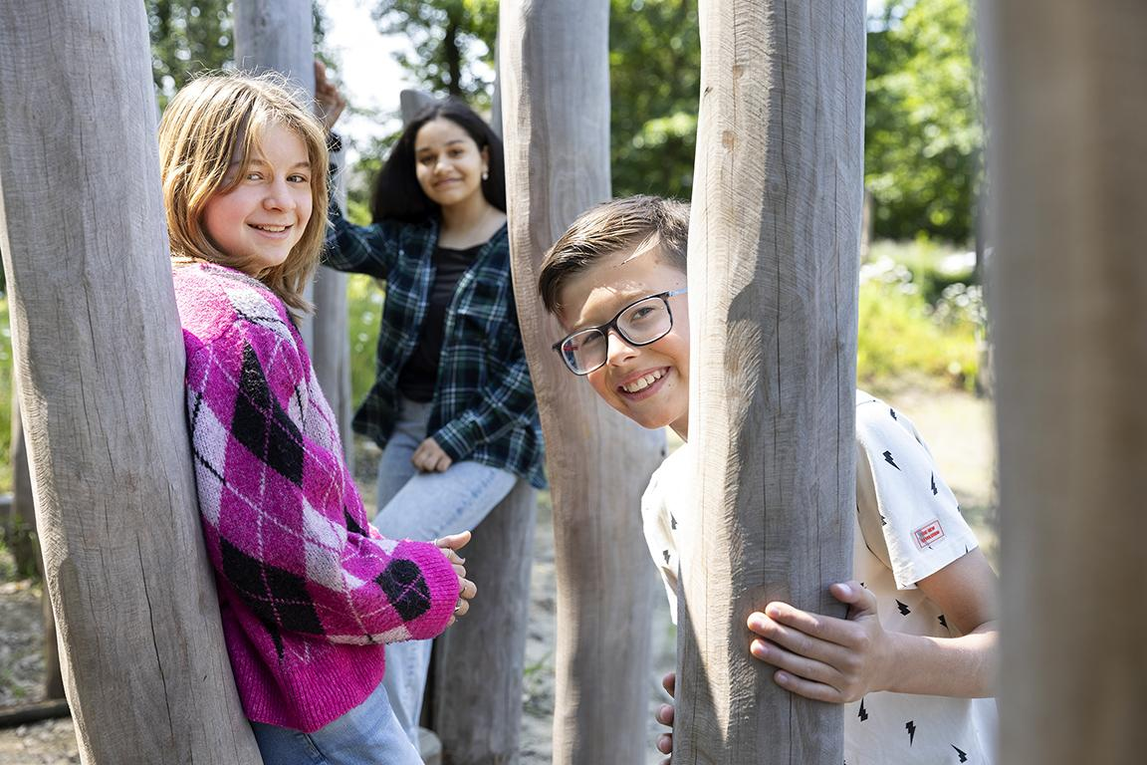
Sharing is caring!
Communication
& information sharing
Student welfare:
      Caretakers/caregivers
Support personal
Student coordinators
Contact moments
Information evenings
Student-Parent-Coach meetings
Teacher-Parent meetings
Parents councils & meetings and support groups.
Student information System – “Somtoday”

Slide 9

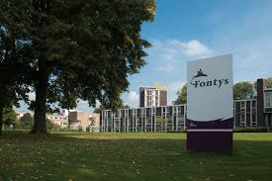
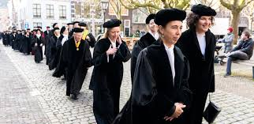
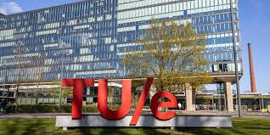
Dutch Secondary Educational Main Routes
Mavo/Vmbo-T: Secondary General Education
Middelbaar Algemeen Voortgezet Onderwijs
Havo: Higher General Secondary Education
Hoger Algemeen Voortgezet Onderwijs
Vwo: pre-university:
Voorbereidend
Wetenschappelijk
Onderwijs
Duration: 4 years
(age range 12-16)
Focus: Prepares students for vocational education and training.
Higher General secondary Education (Havo)
Duration: 5 years
(age range: 12-17)
Focus: Prepares students for universities of applied sciences (HBO)
Pre- University : VWO
Duration: 6 years:
(age range: 12-18)
Focus: Prepares students for University
Gymnasium (Latin & Greek)

Slide 10
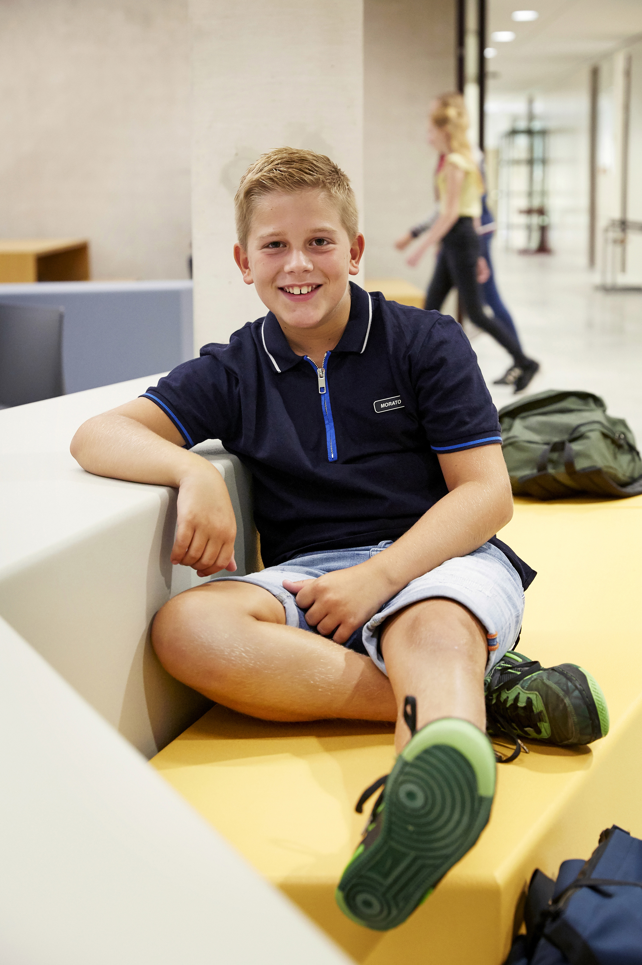
Year 1 in a nutshell!
A great start to your journey of discovery
Mixed ability classes
havo/mavo
TTO havo/mavo
atheneum/havo
TTO atheneum/havo
Advantages:
Gives pupils time to adjust to their new surroundings.
Pupils follow lesson at the highest educational level.
Gives pupils extra time to show which educational routes fits best with their ambitions and educational abilities.

Slide 11
Open day
1 February 2026
Key Dates to remember!
Pick a date to register: Available on line from 18 March 2026 (via our website)
A personal “Meet & Greet” is obligatory if you want to register for the following educational routes:
  “De Campus”
  If you are making the transition from Global College Eindhoven, Parmant Antoon of Parmant Helder.
  Transferring from outside the educational regional area.
  25 t/m 31 March 2026➡️General registration week (via LDOS: you will receive all details from your primary school)
02 April 2026 from 15.30 uur➡️results are posted on LDOS. (Parent portal)
12 May 2026 ➡️ Formal confirmation of secondary school enrolment

Slide 12

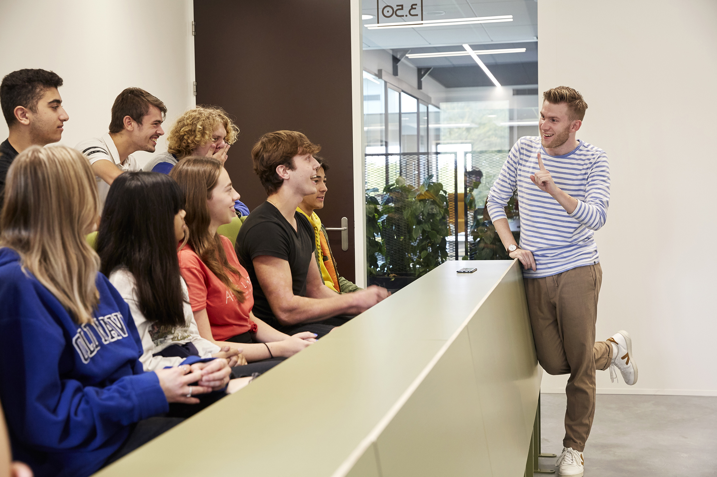
SCE in a nutshell!
Verlofaanvraag
Locations Focus points:
Choose one of the following topics and discover more about our schools’ unique educational opportunities.
In zeer uitzonderlijke gevallen kan extra verlof voor één of voor meerdere dagen aangevraagd worden. Aan extra verlof zitten wettelijk bepaalde regels verbonden. We adviseren om deze goed te bekijken alvorens een aanvraag te doen.
De officiële aanvraagformulieren voor extra verlof zijn te vinden op onze website.
De aanvraag dient ruim op tijd en vooraf ingediend te worden.
De coördinator leerlingzaken neemt hierover een besluit, u ontvangt bericht per e-mail.
TTO: Bilingual education: You may stay here!
NT2 :Dutch as a second language : Room 9.35
Leerlingcoaching: Student guidance: Room 9.36
De Campus: Thematic education: Student lounge 10.01
VWO Plus: Pre-University enrichment programme: Room 9.38
Q & A

